Slide 1




Design and Implementation of a Database Management System for Faculty Workload and Timetable Management System
DBMS PROJECT
SCOPE
PLATFORM
Academic B.Tech database design project implementing a fully normalized relational schema for managing faculty schedules, course assignments, and teaching workload across university departments.
6 Core Entities: Department, Faculty, Course, Section, Room, Timetable, Workload — interconnected through well-defined foreign key relationships and referential integrity constraints.
Schema designed for MySQL 5.7+ / PostgreSQL 10+, normalized to Third Normal Form (3NF) to eliminate redundancy and ensure data consistency across all tables.
ER Diagram
Relational Schema
Sample Data
Entities, attributes, and 1:N cardinality relationships
SQL DDL definitions with PK, FK, and constraints
Filled-in RDBMS tables with realistic university records

Slide 2
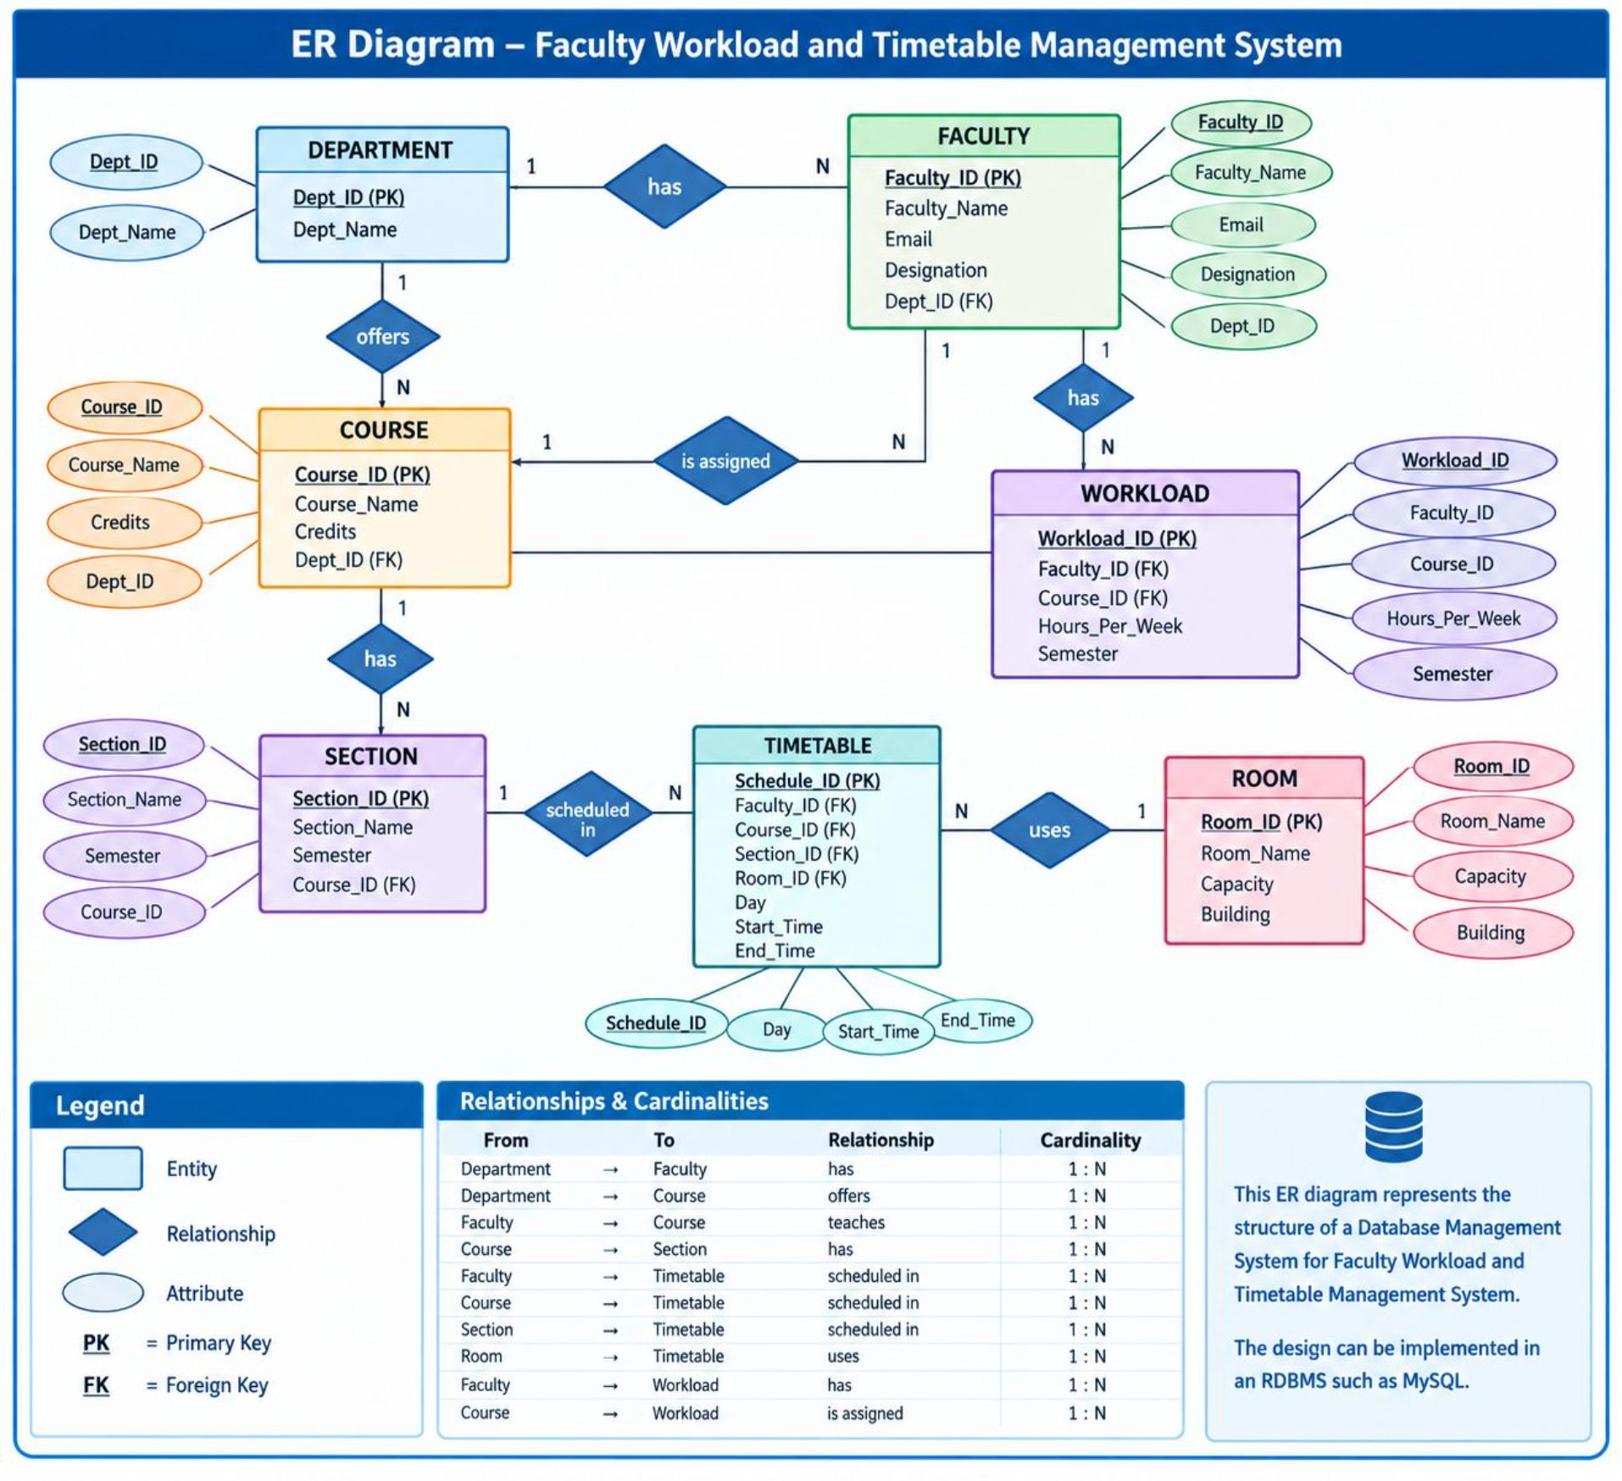

Slide 3
SECTION 2 OF 3
Database Design — Relational Schema
RDBMS Implementation — MySQL / PostgreSQL DDL with Primary Keys, Foreign Keys, and Integrity Constraints
Department
Room
Department(
Dept_ID INT PRIMARY KEY,
Dept_Name VARCHAR(100) NOT NULL
)
Room(
Room_ID INT PRIMARY KEY,
Room_Name VARCHAR(50) NOT NULL,
Capacity INT,
Building VARCHAR(50)
)
Faculty
Faculty(
Faculty_ID INT PRIMARY KEY,
Faculty_Name VARCHAR(100) NOT NULL,
Email VARCHAR(100) UNIQUE NOT NULL,
Designation VARCHAR(50),
Dept_ID INT NOT NULL,
FOREIGN KEY (Dept_ID)
REFERENCES Department(Dept_ID)
)
Timetable
Timetable(
Schedule_ID INT PRIMARY KEY,
Faculty_ID INT NOT NULL,
Course_ID INT NOT NULL,
Section_ID INT NOT NULL,
Room_ID INT NOT NULL,
Day VARCHAR(20),
Start_Time TIME,
End_Time TIME,
FOREIGN KEY (Faculty_ID)
REFERENCES Faculty(Faculty_ID),
FOREIGN KEY (Course_ID)
REFERENCES Course(Course_ID),
FOREIGN KEY (Section_ID)
REFERENCES Section(Section_ID),
FOREIGN KEY (Room_ID)
REFERENCES Room(Room_ID)
)
Course
Course(
Course_ID INT PRIMARY KEY,
Course_Name VARCHAR(100) NOT NULL,
Credits INT,
Dept_ID INT NOT NULL,
FOREIGN KEY (Dept_ID)
REFERENCES Department(Dept_ID)
)
Section
Workload
Section(
Section_ID INT PRIMARY KEY,
Section_Name VARCHAR(50) NOT NULL,
Semester INT,
Course_ID INT NOT NULL,
FOREIGN KEY (Course_ID)
REFERENCES Course(Course_ID)
)
Workload(
Workload_ID INT PRIMARY KEY,
Faculty_ID INT NOT NULL,
Course_ID INT NOT NULL,
Hours_Per_Week INT,
Semester INT,
FOREIGN KEY (Faculty_ID)
REFERENCES Faculty(Faculty_ID),
FOREIGN KEY (Course_ID)
REFERENCES Course(Course_ID)
)
PK: INT Indexing
FK: Referential Integrity
UNIQUE: Email Constraint
3NF Normalization
All primary keys use INT for efficient B-tree indexing and fast lookup performance
Foreign keys enforce consistency — no orphaned records across any related table
Faculty email enforced UNIQUE to prevent duplicate accounts in the system
Schema satisfies Third Normal Form — no transitive dependencies, zero redundancy
Platform Compatibility
Compatible with MySQL 5.7+, PostgreSQL 10+, and standard ANSI SQL RDBMS platforms

Slide 4
SECTION 3 OF 3
Filled-in RDBMS Tables — Sample Data
Realistic university records demonstrating all entity instances and foreign key relationships across the six core tables.
DEPARTMENT
FACULTY
Dept_ID | Dept_Name
101 | Computer Science
102 | Artificial Intelligence
103 | Electronics
104 | Mechanical Engineering
Faculty_ID | Faculty_Name | Email | Designation | Dept_ID
1 | Dr. Ravi Kumar | ravi@univ.edu | Professor | 101
2 | Dr. Priya Sharma | priya@univ.edu | Assoc. Professor | 102
3 | Dr. Arjun Rao | arjun@univ.edu | Asst. Professor | 101
4 | Dr. Sneha Reddy | sneha@univ.edu | Professor | 103
ROOM
COURSE
Room_ID | Room_Name | Capacity | Building
401 | Lab-1 | 60 | Block A
402 | Room-201 | 50 | Block B
403 | Room-301 | 60 | Block B
404 | Lab-2 | 40 | Block A
Course_ID | Course_Name | Credits | Dept_ID
201 | Database Management Systems | 4 | 101
202 | Artificial Intelligence | 4 | 102
203 | Computer Networks | 3 | 101
204 | Machine Learning | 4 | 102
SECTION
Section_ID | Section_Name | Semester | Course_ID
301 | CSE-A | 3 | 201
302 | CSE-B | 3 | 201
303 | AIML-A | 3 | 202
304 | AIML-B | 3 | 204
TIMETABLE
Schedule_ID | Faculty_ID | Course_ID | Section_ID | Room_ID | Day | Start_Time | End_Time
1 | 1 | 201 | 301 | 402 | Monday | 09:00 | 10:00
2 | 1 | 201 | 302 | 403 | Tuesday | 10:00 | 11:00
3 | 2 | 202 | 303 | 401 | Wednesday | 09:00 | 10:00
4 | 3 | 203 | 301 | 402 | Thursday | 11:00 | 12:00
5 | 2 | 204 | 304 | 404 | Friday | 10:00 | 11:00
WORKLOAD
Workload_ID | Faculty_ID | Course_ID | Hours_Per_Week | Semester
1 | 1 | 201 | 6 | 3
2 | 2 | 202 | 5 | 3
3 | 3 | 203 | 4 | 3
4 | 2 | 204 | 5 | 3

Slide 5
SECTION 3 OF 3
Database Relationships — Comprehensive View
A detailed overview of all entities and their relationships, including cardinality and key information, forming the backbone of the university database system.
Relationship Name | Parent Entity | Child Entity | Cardinality | Parent Key | Child Key (FK) | Description
DEPARTMENT-FACULTY | Department | Faculty | 1:N | Dept_ID | Dept_ID | One department employs many faculty members
DEPARTMENT-COURSE | Department | Course | 1:N | Dept_ID | Dept_ID | One department offers many courses
COURSE-SECTION | Course | Section | 1:N | Course_ID | Course_ID | One course has multiple sections per semester
FACULTY-TIMETABLE | Faculty | Timetable | 1:N | Faculty_ID | Faculty_ID | One faculty teaches multiple scheduled classes
COURSE-TIMETABLE | Course | Timetable | 1:N | Course_ID | Course_ID | One course is part of multiple timetable entries
SECTION-TIMETABLE | Section | Timetable | 1:N | Section_ID | Section_ID | One section appears in multiple timetable entries
ROOM-TIMETABLE | Room | Timetable | 1:N | Room_ID | Room_ID | One room hosts multiple classes across the week
FACULTY-WORKLOAD | Faculty | Workload | 1:N | Faculty_ID | Faculty_ID | One faculty has multiple workload entries per semester
COURSE-WORKLOAD | Course | Workload | 1:N | Course_ID | Course_ID | One course contributes to multiple workload records

